Slide 1
Boost Productivity with SAP + Power Platform + Teams + OpenAI
Michael Mergell
November 2023

Slide 2

Our mission is to empower every person and every organization on the planet to achieve more.
SAP Teams will
- become more productive
- deliver better results
- provide faster solutions
- be more successful
- become more inclusive
- …

Slide 3
Use cases & [Connectors]
Use OpenAI within MS Teams [HTTP]
Ask anything privately and safely using your business data
OpenAI-Powered Copilot for SAP Self-Services [SAP ERP]
Check User, Job Status, Communicate a maintenance, …
Ask anything about data in SAP [HTTP + function app]
e.g. How many flights were scheduled on November 28th 2023 per Airline??, …
SAP Product Copilot [SAP ODATA preview]
Ordering assistant, add or change product details, …
SAP Table Copilot [SAP ERP table]
Ask anything about data in one specific tables. E.g. Which airlines operate flights from New York?
SAP Product App [SAP ODATA preview]
Enable mobile workers with access to SAP data

Slide 4





1. ChatGPT like experience in Teams using Power Platform and Azure OpenAI
A user starts a conversation with the copilot in Teams. He can paste business data and ask for review, summary, improving, etc.
The copilot calls the Power Automate Flow
The Flow triggers OpenAI via the HTTP Connector
OpenAI responds to the request and the result is presented within Teams.
Teams
1
Power Automate
Flow
2
3
4
Copilot Studio
HTTP
Connector
Azure Open AI
https://github.com/mimergel/Azure_OpenAi_Chat_in_Teams

Slide 5
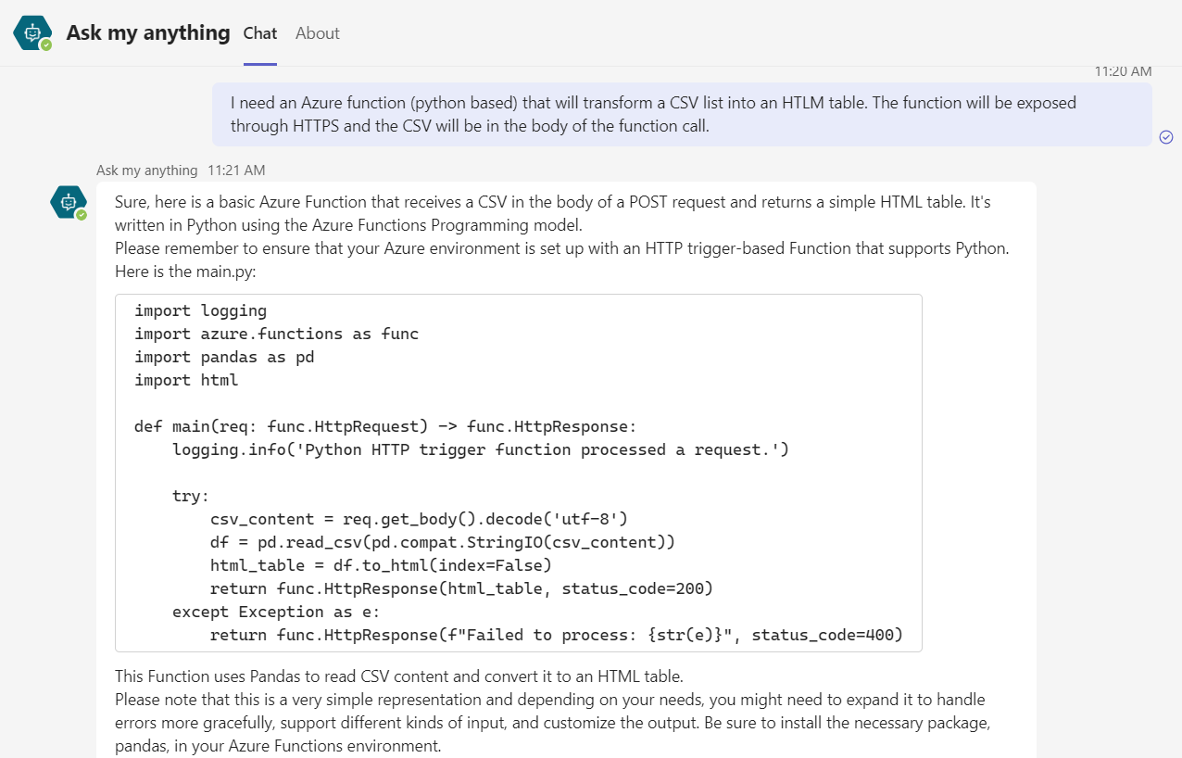
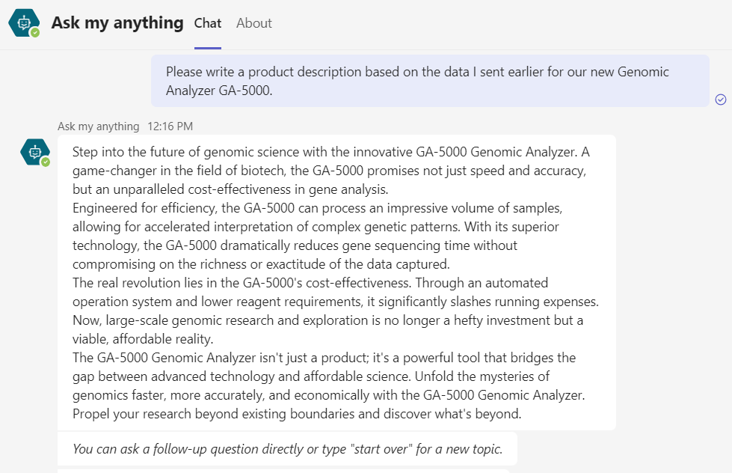
1. Demo: ChatGPT like experience in Teams using Power Platform and Azure OpenAI
https://github.com/mimergel/Azure_OpenAi_Chat_in_Teams

Slide 6






2. SAP Self-Services Copilot
A user starts a conversation with the copilot in Teams.
The copilot calls the flow.
The flow triggers OpenAI via HTTP. The conversation continues until OpenAI knows the intended action and all related information.
Once confirmed, OpenAI sends a JSON message containing the action details. The flow then proceeds accordingly and triggers SAP and other connectors.
The SAP ERP Connector connects to SAP via the Data Gateway and starts the RFC BAPI in SAP.
5
4
SAP Connector
Teams
Azure Data
Gateway
M365 Connectors
1
Power Automate
Flow
2
3
Copilot Studio
HTTP
Connector
Azure Open AI
https://github.com/mimergel/Azure_OpenAI_powered_SAP-Self-Services

Slide 7
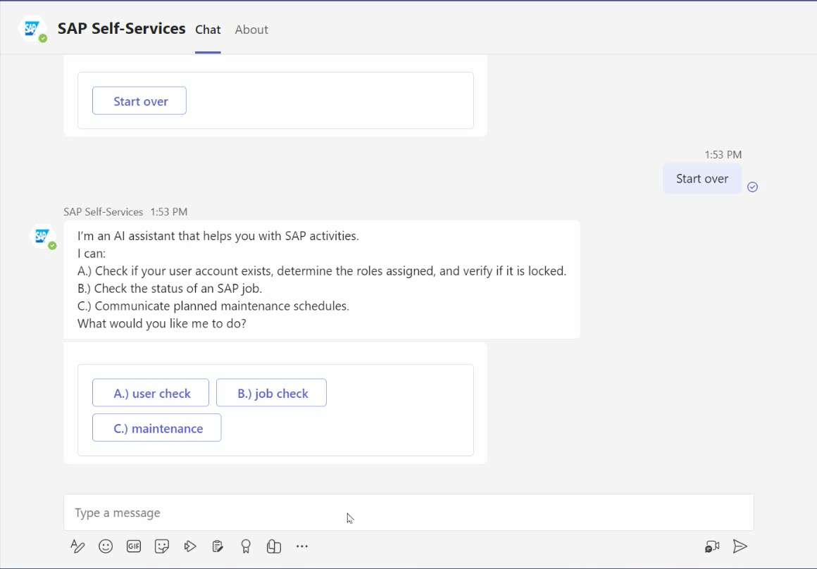
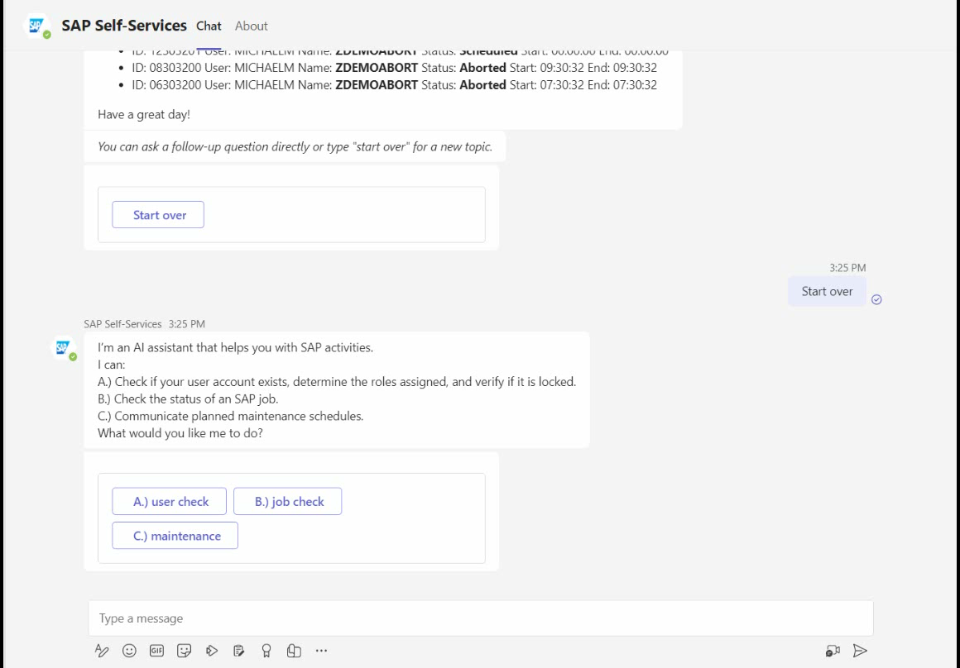
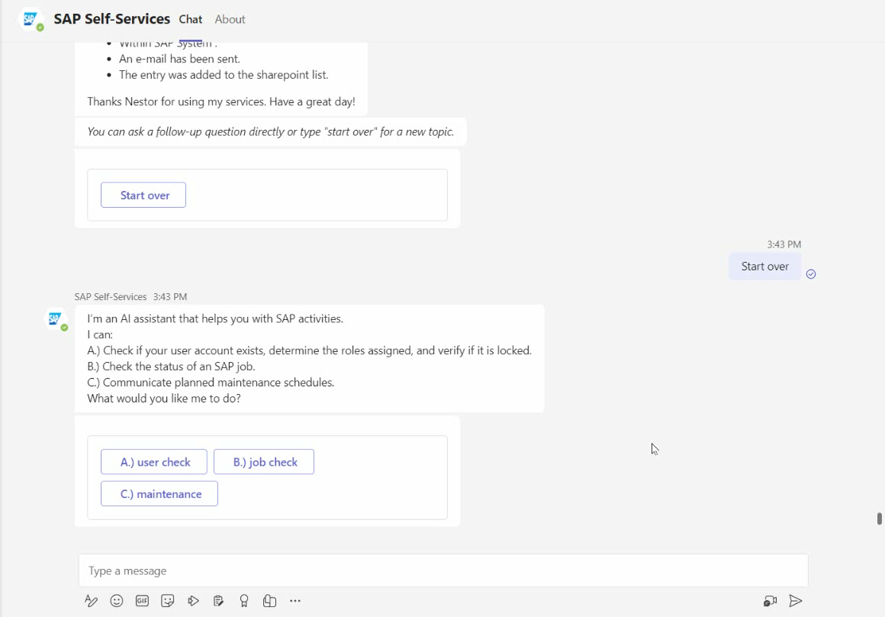
2. Demo: SAP Self-Services
SAP User Check
SAP Job Status Check
Communicate a planned maintenance
https://github.com/mimergel/Azure_OpenAI_powered_SAP-Self-Services

Slide 8

3. Ask anything about your SAP data (or even any data in any DB)
A user starts a conversation with the copilot in Teams.
The copilot calls the flow.
The flow runs a HTTP action that calls Open AI chat.
Open AI gets the question, with instructions including the DB schema. The conversation goes on until a question can be translated into an SQL command.
When there is a SQL in the response the Flow triggers via another HTTP connector a Function App with the SQL as parameter.
The Function App runs the SQL on the database and the results is pushed to Teams as adaptive card including a chart when possible.
6
5
Teams
HTTP
Connector
Function App
1
Power Automate
Flow
2
3
4
Copilot Studio
HTTP
Connector
Azure Open AI
https://github.com/mimergel/Chat_with_your_SAP_Data

Slide 9
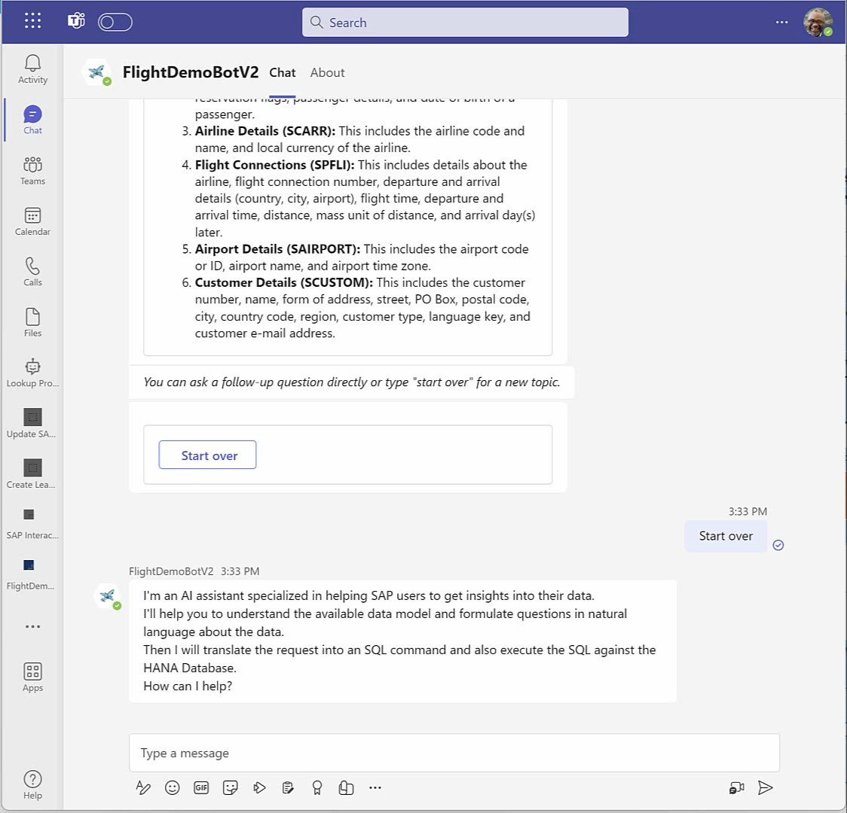
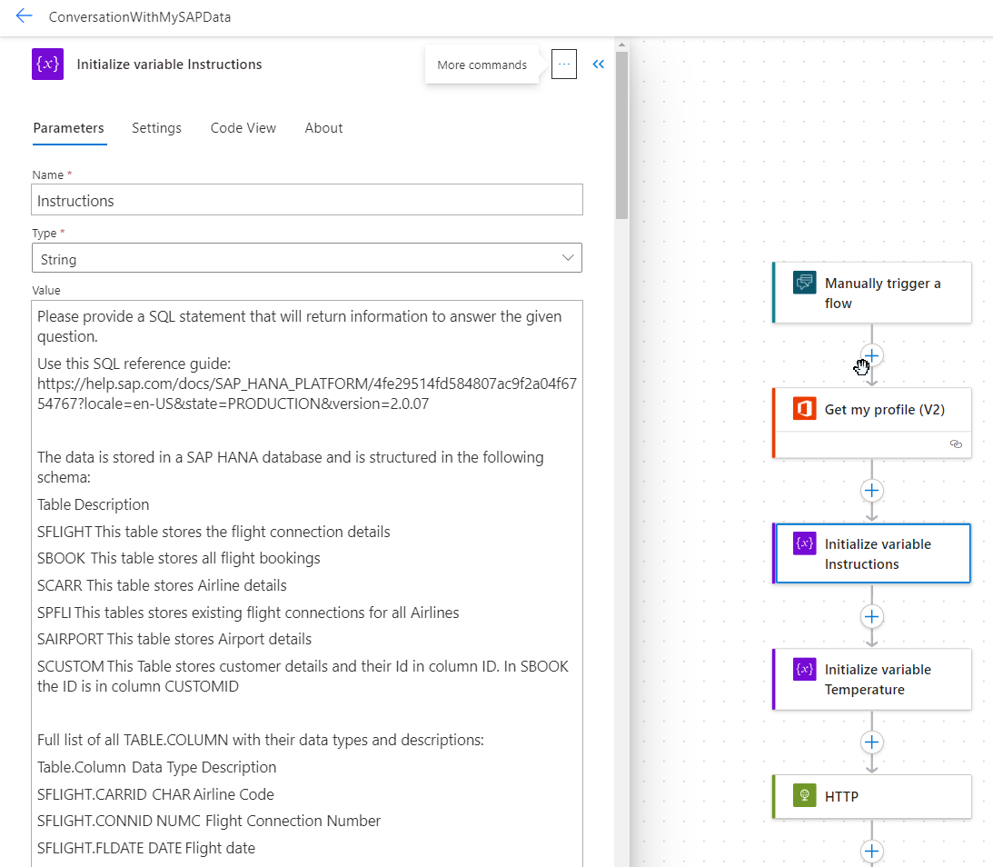
3. Demo: Ask anything about your SAP data
Instructions for OpenAI include the Data Structure
Users in Teams can ask any question about the data in SAP
https://github.com/mimergel/Chat_with_your_SAP_Data

Slide 10


4. SAP Product Copilot
A user starts a conversation with the copilot in Teams.
The copilot calls the flow.
The flow triggers OpenAI via HTTP. The conversation continues until OpenAI has the intended action and all related information.
Once confirmed, OpenAI sends a JSON message containing the action details. The flow then proceeds accordingly and triggers the SAPOData connector.
The SAPOData Connector connects to SAP directly or via the Azure API Management.
5
4
Teams
SAPOData
Connector
(preview)
Azure API
Management
(optional)
1
Power Automate
Flow
2
3
Copilot Studio
HTTP
Connector
Azure Open AI
https://github.com/mimergel/SAP_Product_Copilot

Slide 11
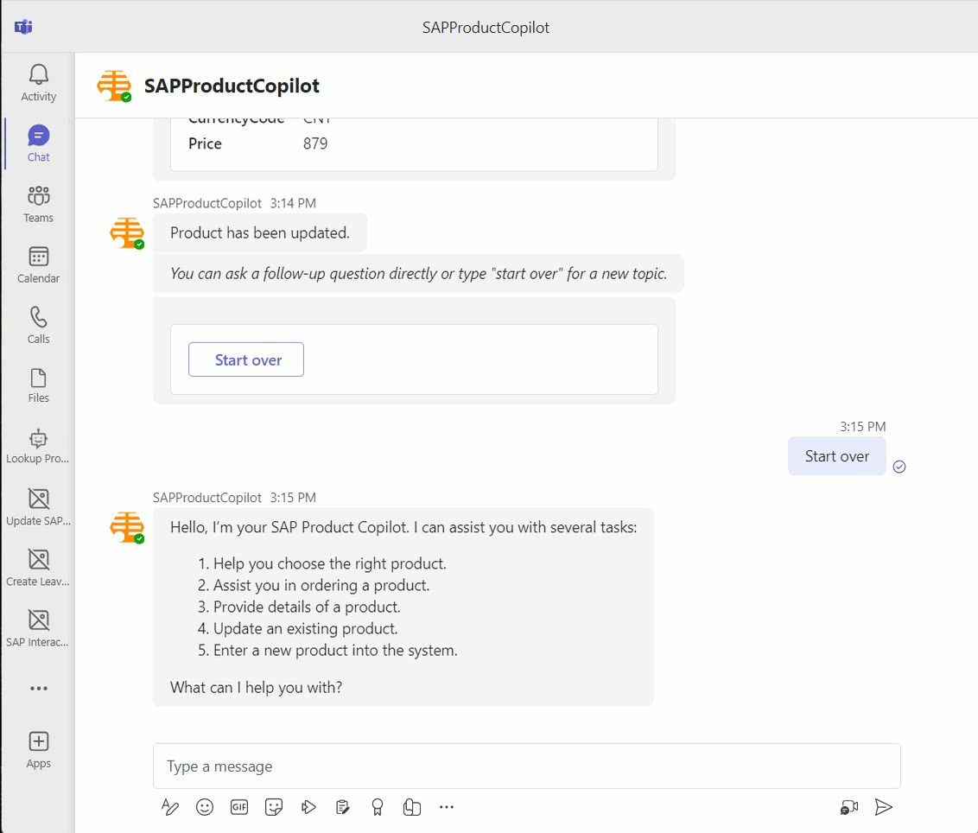

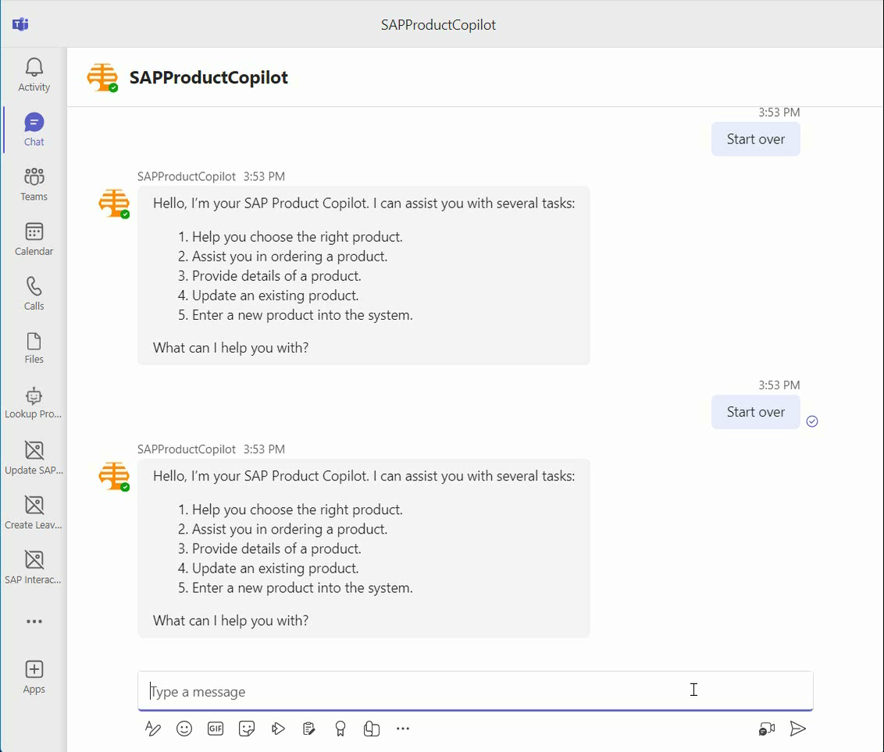
4. Demo: SAP Product Copilot
Get product details / change price
Add new product
Sales assistance (chose right product)
https://github.com/mimergel/SAP_Product_Copilot

Slide 12
5. SAP Table Copilot Ask anything about data in a specific table(s)
A user starts a conversation with the Copilot in Teams.
The Copilot calls the flow.
The flow triggers OpenAI via HTTP. The conversation continues until OpenAI knows the intended action and all related information.
Once confirmed, OpenAI sends a JSON message containing the action details. The flow then proceeds accordingly and triggers SAP and other connectors.
The SAP ERP Connector connects to SAP via the Data Gateway and starts the RFC BAPI in SAP.
The full conversation context including the SAP data is send to OpenAI to draft the best possible response.
5
4
Teams
SAP ERP
Table Connector
Azure Data
Gateway
1
Power Automate
Flow
2
3
6
Copilot Studio
HTTP
Connector
Azure Open AI
https://github.com/mimergel/SAP Table Copilot

Slide 13
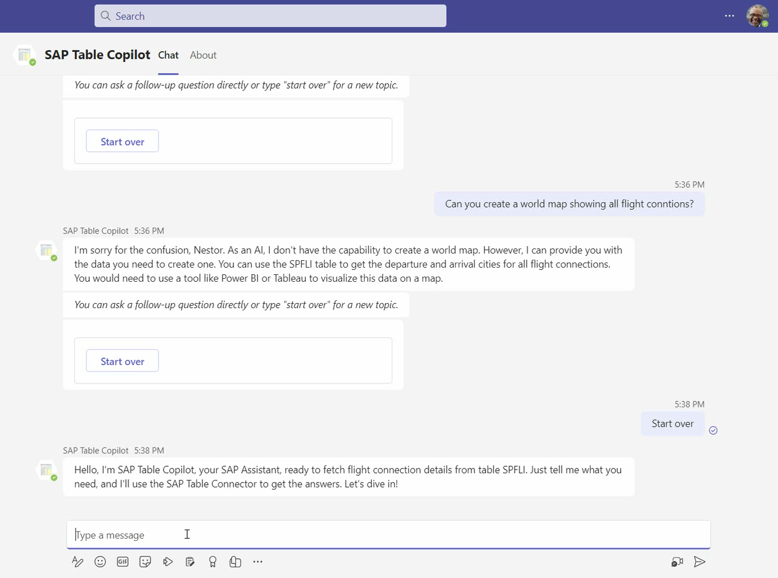
5. Demo: SAP Table Copilot

Slide 14
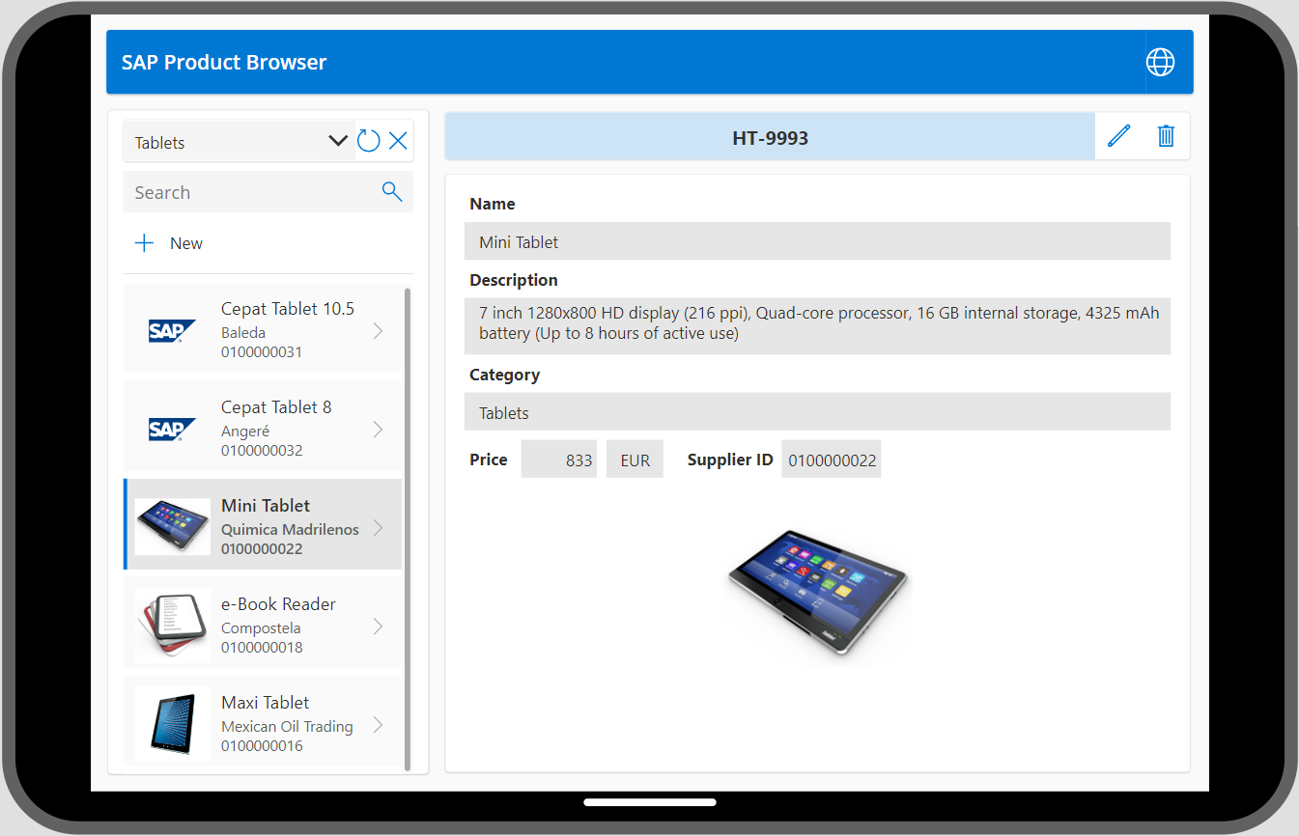
6. SAP Product App

Slide 15

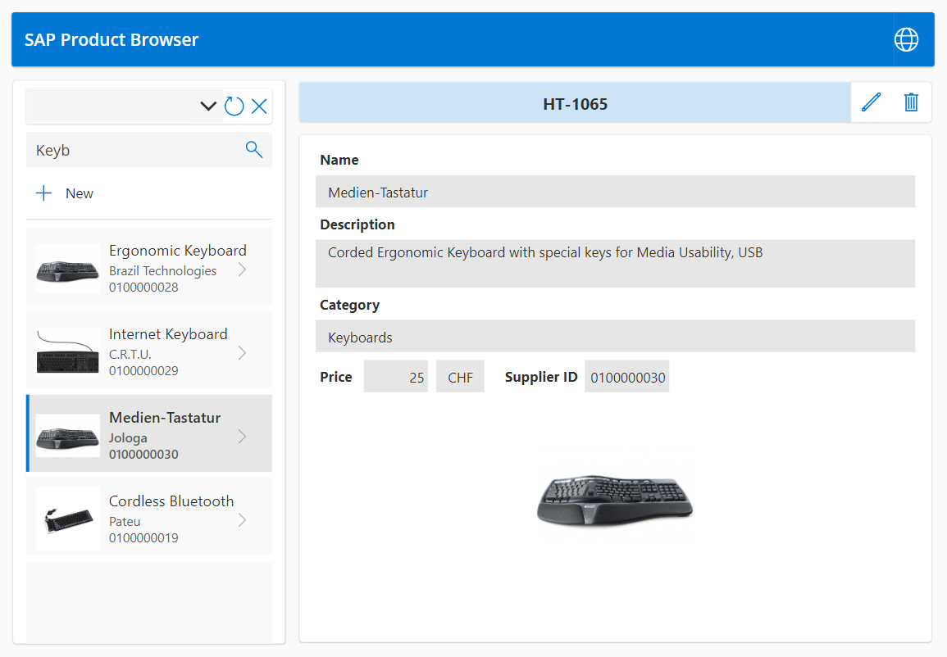
6. SAP Product App
A mobile user works with a Power App that is linked to SAP data. The App triggers the flow depending on inputs. The user can:
read
update
add
delete
The Flow calls the SAP OData Connector and transfers the required and optional parameters and values.
The action is handled on the SAP systems and information depending on chosen action are returned.
Data is updated in the app.
1
4
Power Canvas
App
Power Automate
Flow
2
3
SAPOData
Connector
(preview)
https://github.com/mimergel/SAP_Product_App

Slide 16
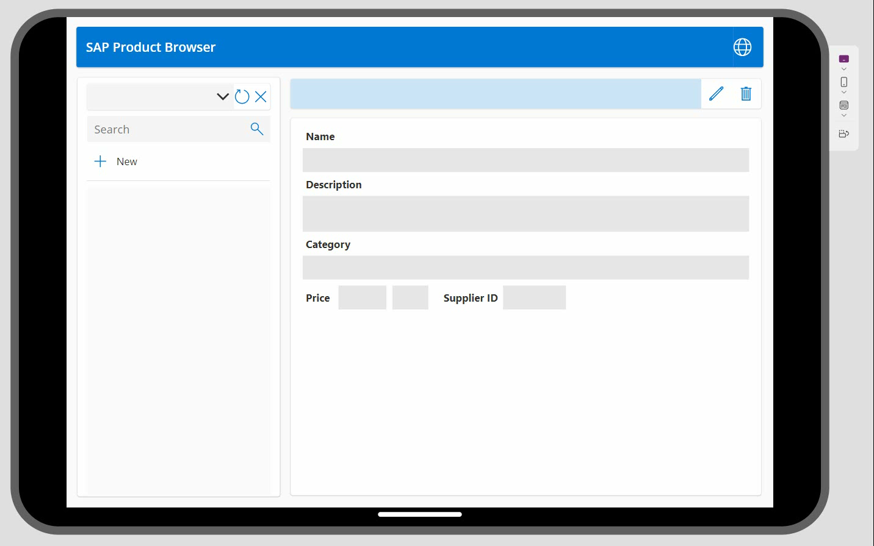
6. Demo SAP Product App

Slide 17
Final slide with logo

